Slide 1
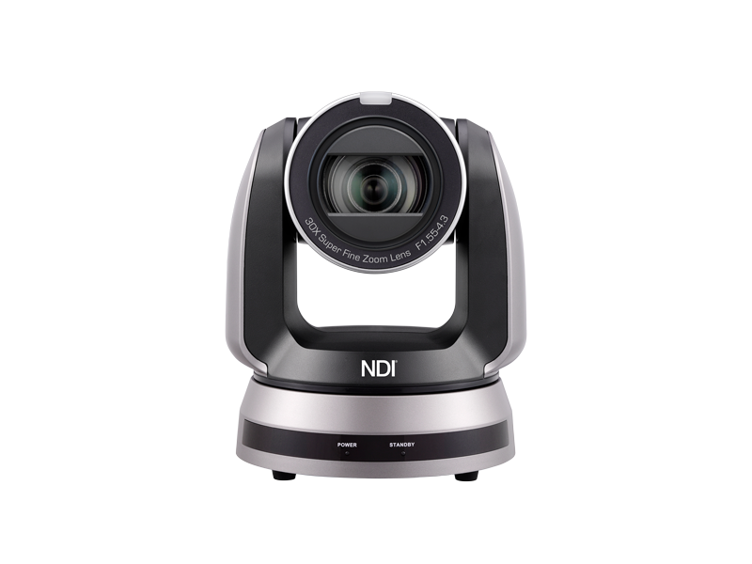
VC-A71P-HN
4K NDI®|HX PTZ Camera
Product Introduction
Notes:
Let’s see the new product introduction. 4K NDI®|HX PTZ Camera , VC-A71P-HN

Slide 2
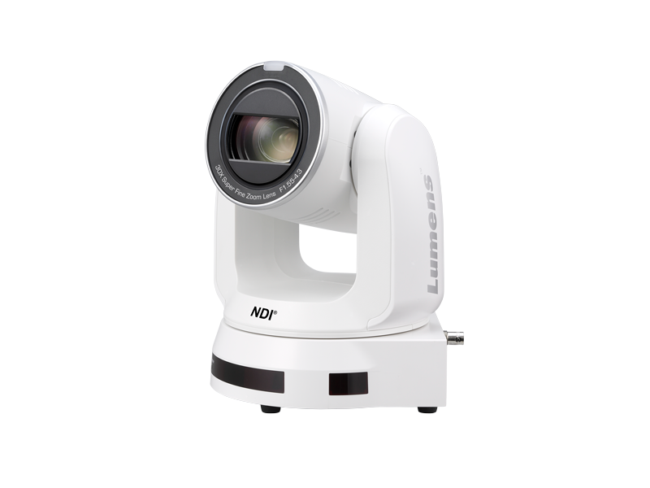
Overview
VC-A71P-HN
4K NDI®|HX PTZ Camera
Color: Black, White
NDAA/TAA Compliant: Yes
Warranty: 5-Year
MAP: $4,995
Notes:
Lumens VC-A71P-HN is a 4K 60fps PTZ camera with 12G-SDI, high bandwidth NDI and NDI®|HX3 outputs.
The color is available for black and white.
It is NDAA and TAA Compliant. and it comes with 5-year warranty.

Slide 3
Product Family
 | VC-A71P-HN | VC-A71PN
Sensor | 1/1.8" 9.17 MP CMOS
Video Format | 4Kp60
Video Output Interface | HDMI, Ethernet, 12G-SDI, 3G-SDI, USB3.0 | HDMI, Ethernet
Genlock | Yes | NA
Optical Zoom | 30x
AR/VR systems | FreeD
Color Space | Standard / BT.2020 / REC.709 | Standard
PoE | POE++ (IEEE802.3bt) | POE+ (IEEE802.3at)
Video Stream Protocol | Full NDI / NDI|HX3 / NDI|HX2 / RTSP / RTMP / RTMPS / MPEG-TS / SRT | NDI|HX2 / RTSP / RTMP / RTMPS / MPEG-TS / SRT
Camera Control Interface | RS-232 / RS-422 / Ethernet / Remote / USB 3.0 | RS-232 / RS-422 / Ethernet / Remote
Camera Control Protocol | VISCA / VISCAIP / PELCO D / NDI / ONVIF / UVC | VISCA / VISCAIP / PELCO D / NDI / ONVIF
Audio Input | Line In / MIC In
Audio Output | Ethernet / HDMI / 12G-SDI / 3G-SDI / USB 3.0 | Ethernet / HDMI
Notes:
VC-A71P-HN is equipped with dual SDI ports, USB 3.0 and featuring genlock and the FreeD protocol.
It support for Rec709 and BT2020 color spaces, it makes the camera suitable for HD and UHD TV workflows.
Featuring full NDI, and also supports the latest version of the NDI protocol, NDI HX3.

Slide 4
Product I/O
VC-A71P-HN Front View
Tally Light
Camera Lens
Status LED indicator
Notes:
On the front, VC-A71P-HN is equipped with tally light and status LED indicator.

Slide 5
Product I/O
VC-A71P-HN Back View
Kensington
Lock Port
NDI®/
ETHERNET
HDMI
Output
3G SDI
Output
12G SDI
Output
USB 3.0
IR
SELECT
DC 12V
Input
RS-232
Output
RS-232
Input
Audio
In
G/L
Input
Output
Switch
RS-422
Notes:
On the back, we have Kensington Lock Port, NDI, Ethernet port, USB 3, HDMI , 3GSDI, 12SDI output port, RS-424, output switch, Genlock input, Audio in, RS-232, DV 12V Input and IR select.

Slide 6
Key Features
4K 60 fps, 30x Optical Zoom, 1/1.8" Sensor
12G-SDI | 3G-SDI | HDMI | IP | USB Output
Genlock Support
Rec.709 | BT.2020 Support
Full NDI | NDI|HX3 | RTSP | RTMP | RTMPS | MPEG- TS | SRT Support
FreeD Protocol for Live VR/AR Production
802.1x Support
Notes:
Here are some key features of VC-A71P-HN.
4K 60 fps, 30x Optical Zoom, 1/1.8" Sensor
12G-SDI | 3G-SDI | HDMI | IP | USB Output
Genlock Support
Rec.709 | BT.2020 Support
Full NDI | NDI|HX3 | RTSP | RTMP | RTMPS | MPEG- TS | SRT Support
FreeD Protocol for Live VR/AR Production
802.1x Support

Slide 7
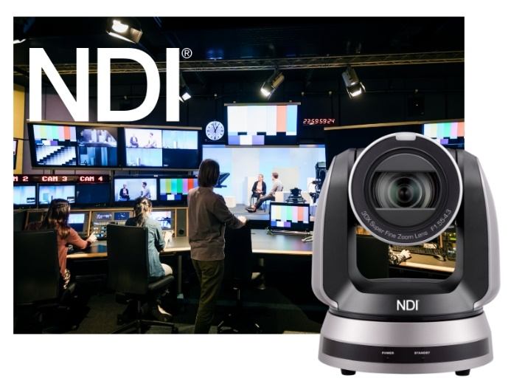
Selling Point
NDI® High Bandwidth
NDI®|HX3 Technology
Featuring full NDI, VC-A71P-HN delivers high-quality video over IP networks with ultra-low latency. Visually lossless, the I-Frame NDI codec is suitable for use in high-end video and TV production, live events and studios.
VC-A71P-HN supports the latest version of the NDI protocol, NDI®|HX3. It delivers high-quality video with very low latency and connects directly to NDI® networks. VC-A71P-HN outputs NDI®|HX3 and full NDI output simultaneously.
Notes:
NDI® High Bandwidth
Featuring full NDI, VC-A71P-HN delivers high-quality video over IP networks with ultra-low latency. Visually lossless, the I-Frame NDI codec is suitable for use in high-end video and TV production, live events and studios.
NDI®|HX3 Technology
VC-A71P-HN supports the latest version of the NDI protocol, NDI®|HX3. It delivers high-quality video with very low latency and connects directly to NDI® networks. VC-A71P-HN outputs NDI®|HX3 and full NDI output simultaneously.

Slide 8
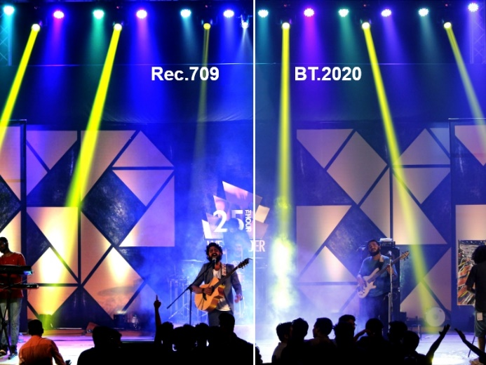
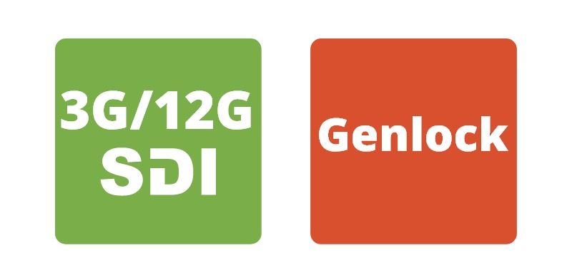
Selling Point
Broadcast Connections
BT.2020/Rec.709
VC-A71P-HN is equipped with dual SDI ports (12G and 3G) and a genlock connector to synchronize broadcast equipment. The camera can be powered over the Ethernet (PoE++); the network port can also be used for SRT and MPEG-TS output, as well as standard web streaming protocols.
Lumens VC-A71P-HN supports the BT.2020 color gamut for wide and precise color reproduction. With BT.2020, VC-A71P-HN can be matched with other cameras and deliver video output optimized for new generation UltraHD monitors.
Notes:
Broadcast Connections
VC-A71P-HN is equipped with dual SDI ports (12G and 3G) and a genlock connector to synchronize broadcast equipment. The camera can be powered over the Ethernet (PoE++); the network port can also be used for SRT and MPEG- TS output, as well as standard web streaming protocols.
BT.2020/Rec.709
Lumens VC-A71P-HN supports the BT.2020 color gamut for wide and precise color reproduction. With BT.2020, VC-A71P-HN can be matched with other cameras and deliver video output optimized for new generation UltraHD monitors.

Slide 9
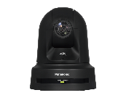
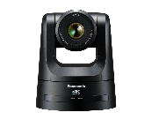
Competitive Product
Item | Model Name | Lumens VC-A71P-HN | Panasonic AW-UE80 | Panasonic AW-UE100
Camera | Price(USD) | $ 4,995 | $ 5,500 | $ 7,295
 | Video Format | 4K60p | 4K60p | 4K60p
 | Sensor | 1/1.8" 9.17 MP CMOS | 1/2.5" MOS | 1/2.5" MOS
 | Video Output Interface | HDMI2.0, Ethernet, 12G-SDI, 3G-SDI, USB3.0 | 3G-SDI, HDMI, Ethernet | HDMI,Ethernet,12G-SDI,3G-SDI,Optical fiber
 | Optical Zoom | 30x | 24x | 24x
 | Horizontal Viewing Angle | 63° | 74.1° | 74.1°
 | Focal Length | 6.5mm ~ 202mm | 4.12 ~ 98.9 mm | 4.12 ~ 98.9 mm
 | Minimum Object Distance | 1.5m (Wide/Tele) | 100 mm(Wide) 1200 mm(Tele) | 100 mm(Wide) 1200 mm(Tele)
 | Focus System | Auto, Manual, Smart AF | Auto, Manual | Auto, Manual
 | Genlock | Yes | Yes | Yes
 | AR/VR systems | FreeD | FreeD | FreeD
Output | HDMI/SDI | HDMI : 4Kp60 12G-SDI : 4Kp60 | HDMI : 4Kp60 3G-SDI : 1080p60 | HDMI : 4Kp60 12G-SDI : 4Kp60
 | IP Stream | HEVC : 4Kp60 H.264 : 1080p60 H.264 : 360p30 | HEVC : 1080p60 | HEVC : 2160p30 H.264 : 2160p60 JPEG (MJPEG) : 2160p30
 | USB Output | H.264 : 2160p30 MJPEG : 1080p30 | NA | NA
Network | Stream Protocol | Full NDI / NDI|HX3 / NDI|HX2 / RTSP / RTMP / RTMPS / MPEG-TS / SRT | RTSP / RTMP / MPEG-TS / SRT / NDI|HX / Full NDI | RTSP / RTMP / SRT / NDI|HX / Full NDI
Camera Control | Protocol | VISCA / VISCAIP / ONVIF / PELCO D / NDI / UVC | Panasonic / NDI | Panasonic / NDI
 | UVC | Yes | NA | NA
 | UAC | Yes | NA | NA
Notes:
Compare with Panasonic AW-UE80 and UE100, Lumens VC-A71P-HN is equipped with 12G-SDI, 3G-SDI and USB 3 output ports. Which offering more flexibility and convenience to integrate with various recording and broadcasting equipment and displays.
Smart AF function intelligently identifies facial characteristics, it can focus quickly and accurately, even in complex environments. Featuring full NDI, and also supports the latest version of the NDI protocol, NDI HX3.

Slide 10
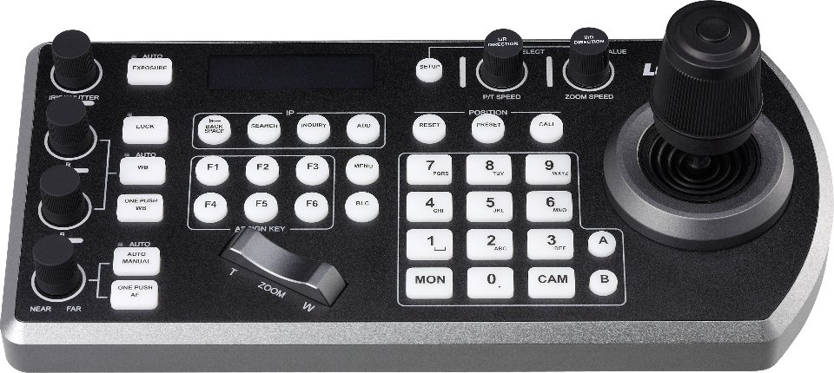
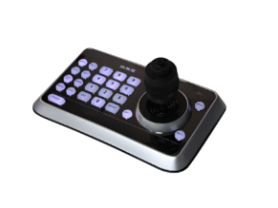
Lumens Products
Integration
LC200
VC-A71P-HN is compatible with Lumens products like media processor LC200, LC100 and Camera controller VS-KB30 and VS-KB20.
LC100
It is also compatible with Lumens software like CamConnect, OBS Plugin, providing users use more convenience.
Media Processor
Software
Wall Mount
VS-KB30
Remote
VS-K20
WM12
RC01
Accessory
Controller
Notes:
VC-A71P-HN is compatible with Lumens products like media processor LC200, LC100 and Camera controller VS-KB30 and VS-KB20.
It is also compatible with Lumens software like CamConnect, OBS Plugin…, providing users use more convenience.

Slide 11
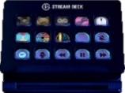
Third Party Partners
Integration
VC-A71P-HN successfully integrates with major Video Conference software, popular streaming platforms, broadcasting software and Stream Deck.
It provides users with more flexible options to use VC-A71P-HN with their desired platforms.
Stream Deck
Video Conference
Streaming Platform
Broadcasting Software
Notes:
VC-A71P-HN successfully integrates with major Video Conference software, popular streaming platforms, broadcasting software and Stream Deck.
It provides users with more flexible options to use VC-A71P-HN with their desired platforms.

Slide 12
More information
Notes:
For more information, please visit our website at www.Mylumens.com

